Slide 1
CHURN MODELLING

Slide 2
Team Name: AVENGERS
Team Leader:
Team Members:
Chandu Hima Vamsi
Anirudh PKV
Varshith G
Sai Pranay
Himaja

Slide 3
Introduction
Churn: A customer is called a churn when he discontinues the services/subscriptions offered by the respective company.
Churn Model: It is a tool that defines the steps and stages of customer churn, or a customer leaving your service or product. Having a predictive churn model gives you awareness and quantifiable metrics to fight against in your retention efforts.
Churn Rate: Churn rate is calculated by dividing the number of customer cancellations within a time period by the number of active customers at the start of that period.

Slide 4
Churn Prediction
Churn Prediction is one of the most popular Big Data used cases in Business.
It consists of detecting customers who are likely to cancel a subscription to a service.
This concerns business of all sizes, including start-ups.
Churn is important because it directly affects your service’s profitability that might lead business owners in order to grow their customer base.
Churn Prediction helps companies to forecast their churns from the used cases and update their services to decrease the churns to the maximum extent.

Slide 5
Churn Analytics
Companies use churn analytics to measure the rate at which customers quit the product, site, or service.
Lower churn rates lead to happier customers, larger margins, and higher profits. To prevent churn, teams must first measure it with analytics.
Churn analytics helps companies plug the leak in their customer bucket, to borrow a common analogy.
It helps to predict the Customer Churn which is the percentage of customers who stopped using the company’s products/ services during a certain timeframe.

Slide 6
Types of Churn
Contractual: Costumers make purchase at discrete intervals, on a contract.
Ex: Netflix.
Non-Contractual: Customers are free to buy.
Ex: Online Shopping.
Voluntary: Customers make the choice to leave the company.
Involuntary: Customers are forced to leave the company.
Ex: Credit card expiration.

Slide 7
Why Python is the preferred language for Machine Learning?
It’s simple to learn. As compared to C, C++ and Java the syntax is simpler and Python also consists of a lot of code libraries for ease of use.
Though it is slower than some of the other languages, the data handling capacity is great.
Open Source! – Python along with R is gaining momentum and popularity in the Analytics domain since both of these languages are open source.
Capability of interacting with almost all the third party languages and platforms.

Slide 8
OBJECTIVE
Main objective of this model is to reduce the loss of customer to a company.
This can be done by knowing the reason for loosing costumers and in return providing offers to attract the costumer.
Customers won’t leave the company if this company provide better benefits than all another companies.
So, company should focus on competition in market and upgrade the company time to time. So, loosing costumers will be reduced.
Company should focus on inconvenience found in customers and should able to reduce the inconvenience as soon as possible.

Slide 9
Problem Statement
Main disadvantage of any company or business is loosing their customer.
Due to increase in churn rate, the company may lose it’s profits or may shut down in the worst case.
With the help of churn rate, company can know the number of customers leaving. So, company can know the reason and attract the customers by giving new offers and improving their drawbacks.
For example, if Netflix knew a segment of customers who were at risk of churning they could proactively engage them with special offers instead of simply losing them.

Slide 10
CONTENT
Customers who left within the last month – the column is called Churn (OUTPUT)
Services that each customer has signed up for – phone, multiple lines, internet, online security, online backup, device protection, tech support, and streaming TV and movies
Customer account information – how long they’ve been a customer, contract, payment method, paperless billing, monthly charges, and total charges
Demographic info about customers – gender, age range, and if they have partners and dependents
Dataset contains information of about 7043 customers regarding all the above columns.

Slide 11
COLUMNS
gender: Whether the customer is a male or a female
SeniorCitizen: Whether the customer is a senior citizen or not (1, 0)
Partner: Whether the customer has a partner or not (Yes, No)
Dependents: Whether the customer has dependents or not (Yes, No)
tenure: Number of months the customer has stayed with the company
PhoneService: Whether the customer has a phone service or not (Yes, No)
MultipleLines: Whether the customer has multiple lines or not (Yes, No, No phone service)
OnlineSecurity: Whether the customer has online security or not (Yes, No, No internet service)
OnlineBackup: Whether the customer has online backup or not (Yes, No, No internet service)
DeviceProtection: Whether the customer has device protection or not (Yes, No, No internet service)
TechSupport: Whether the customer has tech support or not (Yes, No, No internet service)
StreamingTV: Whether the customer has streaming TV or not (Yes, No, No internet service)
StreamingMovies: Whether the customer has streaming movies or not (Yes, No, No internet service)
Contract: The contract term of the customer (Month-to-month, One year, Two year)
PaperlessBilling: Whether the customer has paperless billing or not (Yes, No)
MonthlyCharges: The amount charged to the customer monthly
Churn: Whether the customer churned or not (Yes or No)

Slide 12
TECHNICAL DESCRIPTION
We have performed EDA to understand and analyze the data. Then used classifiers to improve accuracy of the model.
In EDA we used describe , corr, cov and plotted graphs to analyze the data.
We have used KNN, logistic regression, decision tree, SVM and random forest classification to improve accuracy.

Slide 13
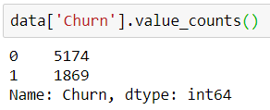
EXPLORATORY DATA ANALYSIS
Number of Churns in the company:
So, 5174(73%) customers out of 7043 customers are willing to continue to get the services of this company (who are not churns), While the rest 27% are willing to discontinue their services of this company (who are churns) i.e., 1869 out of 7043.

Slide 14
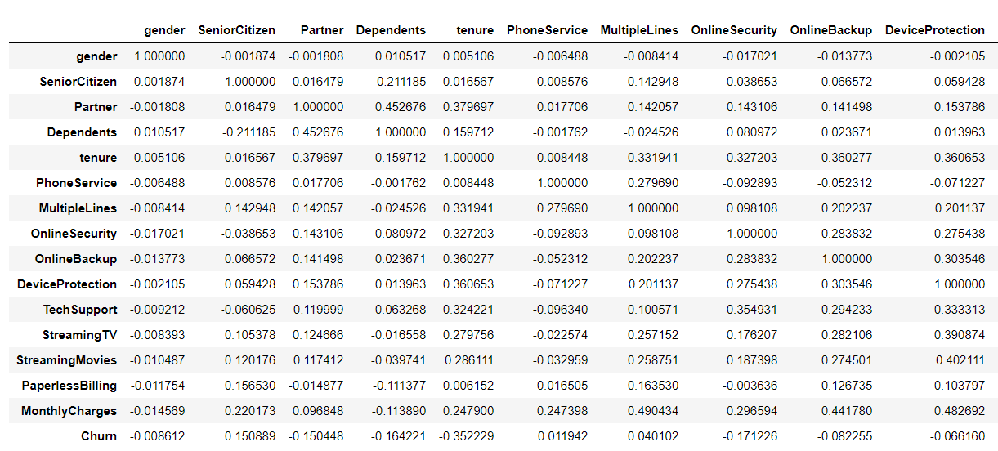
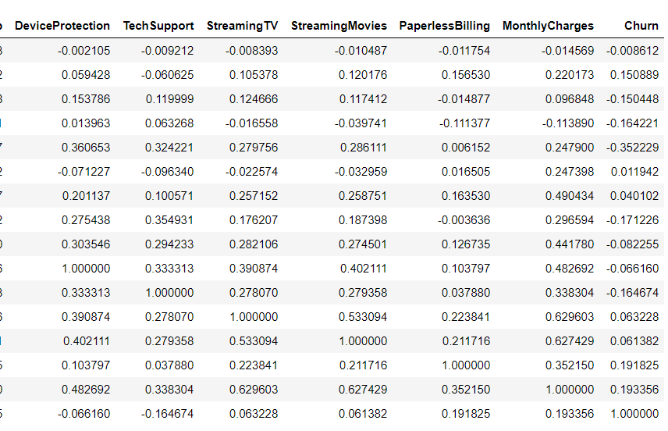
Contd..
Correlation Matrix:
Highest Positive correlation is for StreamingMovies and MonthlyCharges i.e., 0.629603
Highest Negative correlation is for tenure and churn i.e., -0.352228
Churn is strong positively correlated with Paperless Billing.

Slide 15
CLASSIFICATION
K-NEAREST NEIGHBOURS:
Accuracy score: 77.337110
Recall score: 54.166667
ROC score: 70.079442
[[221 36]
[44 52]]
Confusion matrix:
221 out of 353 customers are detected by the model as churns and they are actually churns
36 out of 353 customers are detected by the model as they churns but they are actually not churns
44 out of 353 customers are detected by the model as they are not churns but those customers are churns actually
52 out of 353 customers are detected by the model as they are not churns and the customers are also not churns in reality

Slide 16
CONTD…
LOGISTIC REGRESSION:
Accuracy score: 82.436261
Recall score: 58.510638
ROC score: 74.815165
[[236 23]
[39 55]]
Confusion matrix:
236 out of 353 customers are detected by the model as churns and they are actually churns
23 out of 353 customers are detected by the model as they churns but they are actually not churns
39 out of 353 customers are detected by the model as they are not churns but those customers are churns actually
55 out of 353 customers are detected by the model as they are not churns and the customers are also not churns in reality

Slide 17
CONTD…
SUPPORT VECTOR CLASSIFICATION:
Accuracy score: 78.470255
Recall score: 58.510638
ROC score: 72.112462
[[222 37]
[39 55]]
Confusion matrix:
222 out of 353 customers are detected by the model as churns and they are actually churns
37 out of 353 customers are detected by the model as they churns but they are actually not churns
39 out of 353 customers are detected by the model as they are not churns but those customers are churns actually
55 out of 353 customers are detected by the model as they are not churns and the customers are also not churns in reality

Slide 18
CONTD…
NAÏVE BAYES CLASSIFICATION:
Accuracy score: 77.337110
Recall score: 79.787234
ROC score: 78.117555
[[198 61]
[19 75]]
Confusion matrix:
198 out of 353 customers are detected by the model as churns and they are actually churns
61 out of 353 customers are detected by the model as they churns but they are actually not churns
19 out of 353 customers are detected by the model as they are not churns but those customers are churns actually
75 out of 353 customers are detected by the model as they are not churns and the customers are also not churns in reality

Slide 19
CONTD…
DECISION TREE CLASSIFICATION:
Accuracy score: 73.937677
Recall score: 57.446809
ROC score: 68.684794
[[207 52]
[40 54]]
Confusion matrix:
207 out of 353 customers are detected by the model as churns and they are actually churns
52 out of 353 customers are detected by the model as they churns but they are actually not churns
40 out of 353 customers are detected by the model as they are not churns but those customers are churns actually
54 out of 353 customers are detected by the model as they are not churns and the customers are also not churns in reality

Slide 20
CONTD…
RANDOM FOREST CLASSIFICATION:
Accuracy score: 81.586402
Recall score: 57.446809
ROC score: 73.897149
[[234 25]
[40 54]]
Confusion matrix:
234 out of 353 customers are detected by the model as churns and they are actually churns
25 out of 353 customers are detected by the model as they churns but they are actually not churns
40 out of 353 customers are detected by the model as they are not churns but those customers are churns actually
54 out of 353 customers are detected by the model as they are not churns and the customers are also not churns in reality

Slide 21
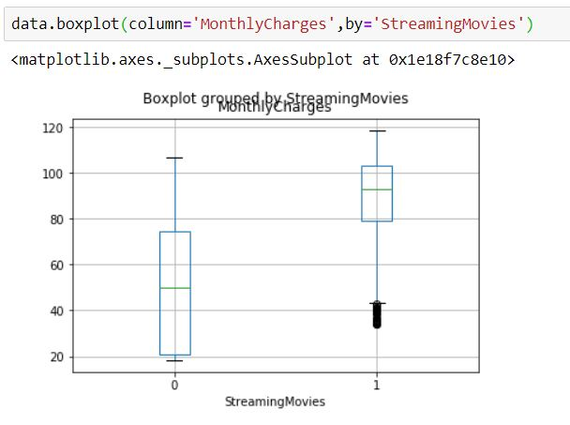
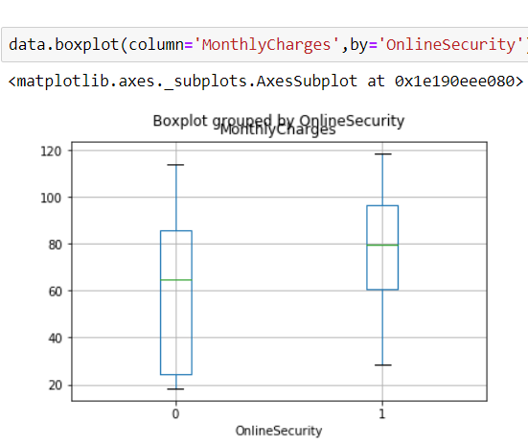
DATA VISUALISATION:
Boxplot for Monthly Charges with Streaming Movies
Boxplot for Monthly Charges by Online Security

Slide 22
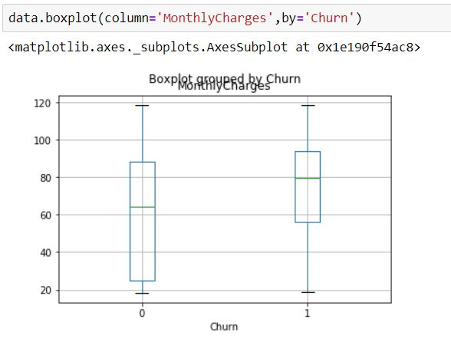
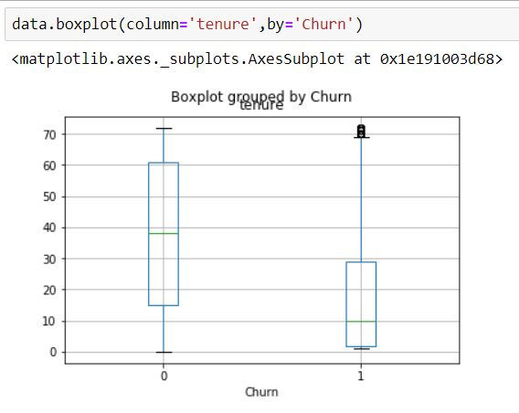
Contd..
Boxplot for MonthlyCharges by Churn
Boxplot for tenure by Churn:

Slide 23
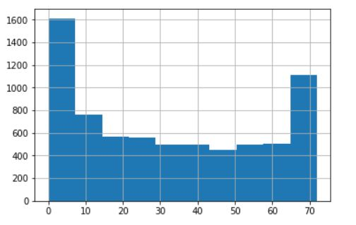
Contd..
Histogram of tenure:
Majority of the customers have a tenure of 7 months (1600) and the least are of tenure 43 to 51 months(450).
The maximum tenure is of 72 years.

Slide 24
FINDINGS AND SUGGESTIONS:
Customers with high monthly charges are becoming churns i.e., discontinue their services with the company. Hence to reduce the loss of customers, the company should decease the monthly charges.
Since customers who are streaming movies and having online security are paying high monthly charges, by reducing the charges on streaming movies, there is a chance of reducing loss of customers.

Slide 25
Conclusion
Churn Modelling helps to find the number of customer loosing in a time period.
Logistic Regression is the best model so far with highest Accuracy score among all the other classification models.
So, this can be used for predicting the churns of the company and so by said to be the solution of their problem

